Slide 1

CoderDojoTo
Continuing Coding

Slide 2
What is code?
Code, in computing, is program language.
There are many different types of program languages used by different software and hardware. Just like the many human languages, program languages have rules to follow and spelling to consider. They also allow you to get creative within those rules. Unlike human languages, different program languages can work together to create more powerful programs. Sometimes, one program language can greatly enhance another.
Before we can write our poetry with code, we must first learn some of the rules

Slide 3
Web program languages
In web development, there are 3 types of web code that do different jobs:
Markup
Document Object Model (The DOM)
Server-side
You guessed right if you guessed that these languages work together.

Slide 4
Web code: HTML
Markup is what gives a web page it’s structure. HTML (or, Hyper Text Markup Language) is the old reliable champion of web markup. Every web browser is built to read HTML, though different browsers can read things slightly differently. Think of a web page as a human body, it has different parts that do different things. Markup is like the bones.
<html>
<head>
</head>
<body>
</body>
</html>

Slide 5
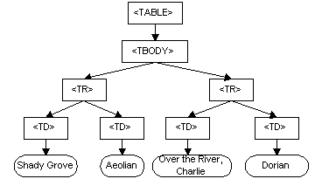
Web Code: The DOM
The DOM, in a nutshell, is an object. In code, you can picture an object like a family tree. There are parents and children and grandchildren nodes, and they all have names and are unique.
The only difference here is that there will only ever be one parent.

Slide 6

Web Code: DOM Traversal
Let’s pause and look around with Mozilla’s X-Ray Goggles tool. This tool is similar to more advanced developer tools, and it is performing an action called traversing the DOM.
https://goggles.webmaker.org/

Slide 7
Web Code: JavaScript
Just as web browsers use the HTML standard to read markup, browsers also use JavaScript (also known (to the very nerdiest) as ECMAScript). JavaScript does an excellent job at DOM traversal, telling us information about what a user is interacting with on a web page.
It can be used to perform interactive tasks like popping up a slideshow gallery when you click a thumbnail image, or switch tabs within a web page. It can also be used to send and receive data in the background, silently, as a user interacts with the program.
Keep in mind, all things in the browser run on your computer, relying on your resources to do the work. This is known as ‘client-side’, browsers are the client.

Slide 8
Web Code: Server-side
Server-side code gives a web page access to web server resources - this can include datestamps, access to data sources, and can perform program logic. This is often similar logic to JavaScript language, except it runs on this code is run on the web server, relying on those services to do the work.
Some examples of server side code are PHP, and Ruby. Similar languages, different manufacturers.
There is a performance trade-off coding for server vs client, tip for all the future pros in the room.

Slide 9
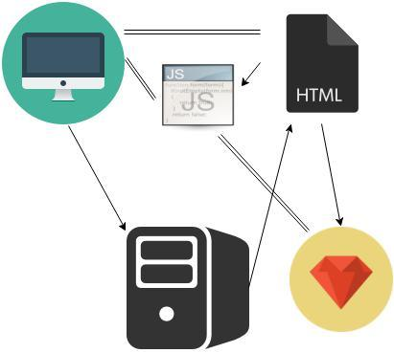
Put it all together
The very basics of what it looks like

Slide 10
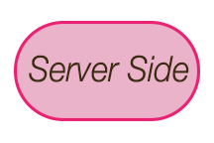
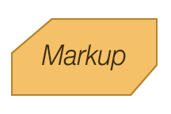
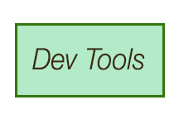
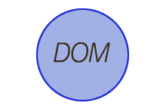
Let’s code!
HTML & CSS http://www.codecademy.com/tracks/web
JavaScript http://javascript-roadtrip.codeschool.com
Ruby http://www.codecademy.com/tracks/ruby
Developer Tools - https://www.codeschool.com/courses/discover-devtools

Slide 11
Learning resources
Codeacademy: http://www.codeacademy.com
Codeschool: http://www.codeschool.com/
Mozilla Webmaker: https://webmaker.org/
Scratch - http://scratch.mit.edu/
Lightbot - http://light-bot.com/
Move the turtle - http://movetheturtle.com/
Hopscotch - http://www.gethopscotch.com/
Treehouse - http://teamtreehouse.com/
Lynda - http://www.lynda.com
Coursera - https://www.coursera.org/

